Slide 1
Community Giving At Its Best
Training 101
May 2, 2017
GiveChoose.org

Slide 2
Today’s Agenda
1:00 – 2:00
Welcome & Introductions — Amy Owen
Overview of Give Choose — Amy
Social Media 10 1— Cyndi Urbano
Q&A - (All)

Slide 3
What is it?
One day - 24 hour online fundraising event organized by the Community Foundation for Loudoun and Northern Fauquier Counties.
To inspire our community to come together for 24 hours to give as much as possible to our local NPOs.
24 hours of giving begins at midnight on May 2nd and ends at 11:59 PM.
Early giving begins April 18th at 12:01 AM
Each nonprofit will have their own donation page to include videos, giving levels, pictures, and testimonials.
Throughout the day, individuals can view online profiles of your nonprofit and make a charitable gift on GiveChoose.org

Slide 4
Why participate?
Visibility:
for your organization and for the local
nonprofits in our area.
Capitalize On A Moment In Time:
one day - 24 hours -
brings energy and momentum.
Be A Part Of Something Big:
an important local community
movement.
Create Stronger Alignment:
Board, Donors, Community.
Prizes, Prizes, Prizes: oh boy.

Slide 5
Why participate?
Individual Giving is the #1 source of revenue for nonprofits. Nationwide, 70% of charitable giving comes from individuals.
Raise Unrestricted Dollars: unrestricted dollars are hard to come by.
New Giving Behavior: Giving Days help introduce and reinforce new giving behaviors that can help lead to greater year round giving.
Reach New Donors: 33% of donations in both 2014 and 2015 came from new donors; 55% in 2016.

Slide 6
History of Give Choose
 | 2014 | 2015 | 2016
Donations | $65,000 | $136,000 | $180,000
NP Matching Gifts | 6 | 12 | 24
Number Donors | 604 | 936 | 922
Participating Nonprofits | 40 | 48 | 60

Slide 7
Give CHOOSE PLATFORM
Robust platform that offers you logo, summary of your programs, giving levels, and multimedia
Businesses Challenge conducying in house campaigns.
Schedule fonations two weeks in advance - April 18th
Banner on Toll Toad leading up to May 2rd
Wee cards
Posters
Community Foundation Facebook Ads to reach new donors

Slide 8
how much does it cost?
Nothing – up front
All donations are fully tax-deductible. Of each gift, 4.99% covers credit card fees and helps to offset Give Choose expenses
It will take the Community Foundation up to 60 days to disperse funds (to allow for credits and reconciliation)

Slide 9
Eligibility & Requirements
501(c)(3) public charity in good standing with the IRS (Fiscal sponsorship and funds within the Community Foundation accepted)
Must be headquartered, have a branch or provide direct services to either Loudoun or Fauquier Counties.
Apply with a preliminary profile on GiveChoose.org by March 24. Be sure to include Statement of Agreement
Complete your profile by April 1

Slide 10
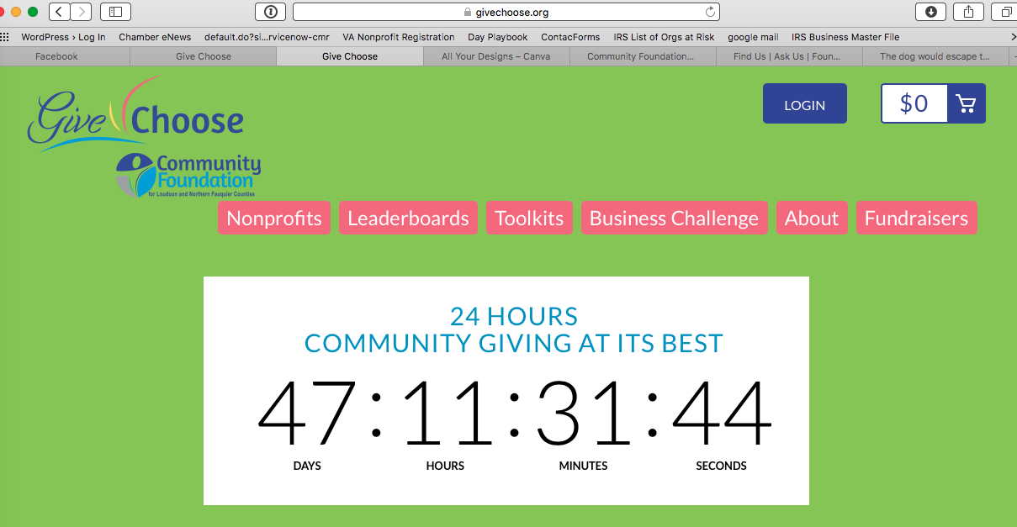
Registration dealine march 24

Slide 11
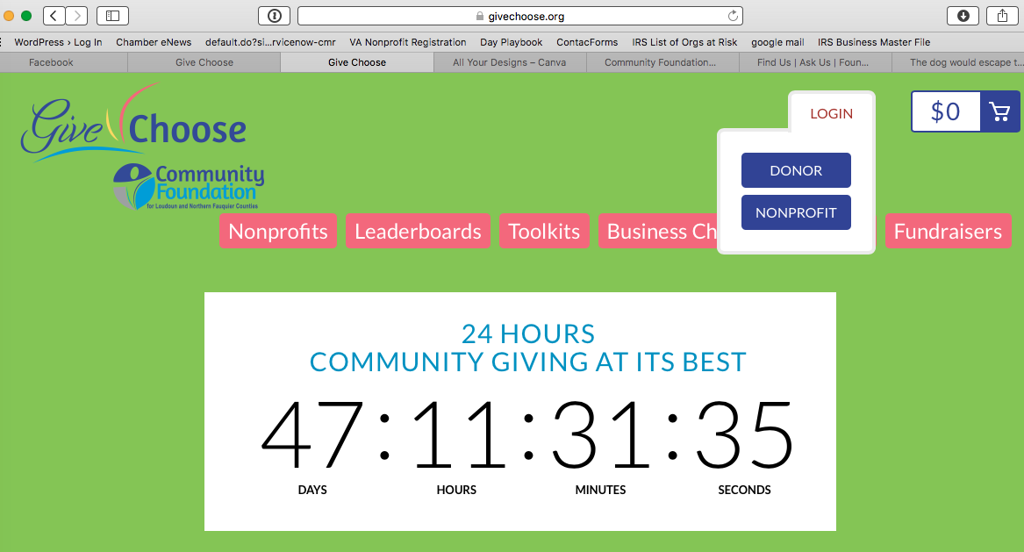
Registration dealine march 24

Slide 12
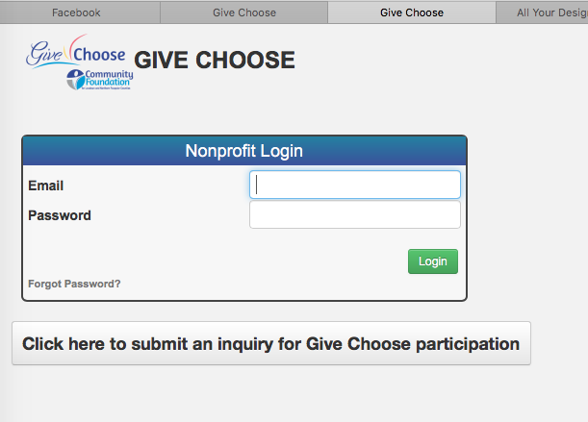
Registration dealine march 24

Slide 13
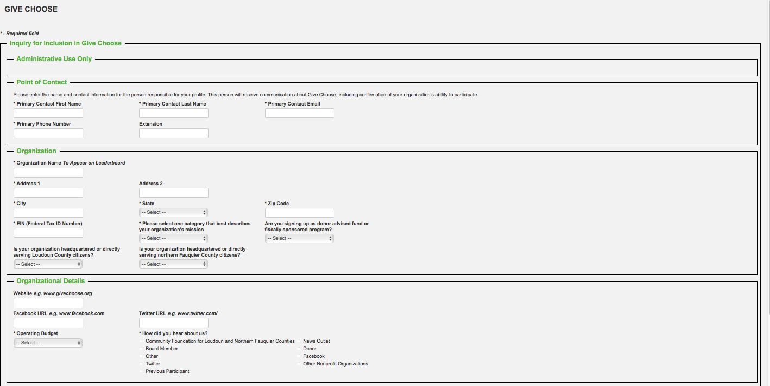
Registration dealine march 24
Logos
Mission
Matching/Challenge Gift

Slide 14
Community Giving At Its Best
Training 202
May 2, 2017
GiveChoose.org

Slide 15
Today’s Agenda
2:00 – 4:30
Welcome & Introductions — Amy Owen
Overview of Give Choose — Amy
A new link: LinkedIn — Judy Schramm
Social Media and Action Plan 202— Cyndi Urbano
Q&A — (All)

Slide 16
goals for 2017
$230,000 in Donations
25 NPOs have Matching Gifts
1,200 Donors
75 Nonprofits

Slide 17
donors: what’VE we learned
How Did You Learn About Give Choose?
 | 2016 | 2015 | 2014
Email from a charity | 66% | 72% | 51%
Email from the Community Foundation | 17% | 21% | 1%
Email from some other source | 3% | 7% | 2%
A friend/family member told me | 25% | 14% | 26%
I saw it in print/media | 4% | 5% | 1%
I saw it in electronic media | 11% | 12% | 2%
I saw a poster | 9% | 9% | 2%
I saw it on Facebook | 24% | 22% | 44%
I saw it on Twitter | 3% | 2% | 1%
I saw it on Tollroad | 7% | n/a | n/a

Slide 18
donors: what we’VE learned
What Charities Did You Support During Give Choose?
 | 2016 | 2015 | 2014
Groups I support or have supported in the past | 86% | 74% | 64%
Groups I have heard of but never supported | 25% | 33% | 35%
Groups I discovered through Give Choose | 9% | 3% | 12%
*In 2014 of the 604 donors, 215 had never before given a gift to that Nonprofit
*In 2015 of the 936 donors, 312 had never before given a gift to that Nonprofit
*In 2016 of the 922 donors, 502 had never before given a gift to that Nonprofit

Slide 19
donors: what we have learned
How long have you lived/worked in Loudoun/Fauquier?
 | 2016 | 2015 | 2014
Less than one year | 4% | 0% | 0%
1 - 2 Years | 5% | 5% | 2%
3 - 5 Years | 9% | 5% | 7%
6+ Years | 71% | 76% | 47%
I do not live or work here. | 11% | 14% | 44%
Did you tell other people about Give Choose?
 | 2016 | 2015 | 2014
Yes | 65% | 14% | 58%
No | 35% | 86% | 42%

Slide 20
donors: what we learned
Our Sponsors helped to create a Prize Pool. How influential were those prizes as you decided to give?
 | 2016 | 2015 | 2014
Very Influential | 14% | 21% | 28%
Influential | 25% | 12% | 26%
Indifferent | 12% | 15% | 13%
Not Influential | 23% | 28% | 16%
I did not know about the Prize Pool | 26% | 24% | 16%

Slide 21
donors: what we’ve learned
Some NPs had matching gifts set up in advance from donors to match your gift made. How compelling were matches as you decided to give?
 | 2016 | 2015
Very Compelling | 25% | 31%
Compelling | 30% | 29%
Indifferent | 13% | 9%
Not Compelling | 17% | 12%
I did not know about Matching Gifts | 16% | 19%

Slide 22
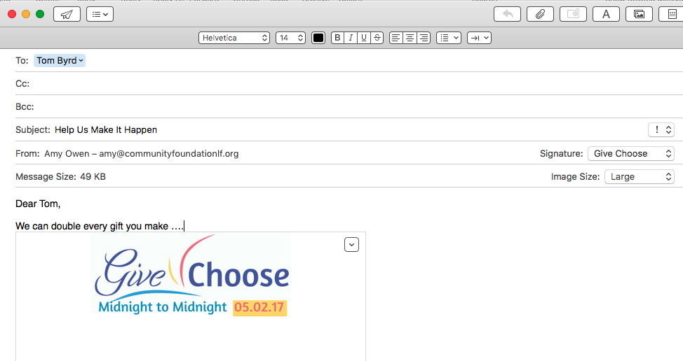
donors: what we learned
The Value of Challenge Gifts
55% to 60% say they were influenced by YOUR Challenge Gift

Slide 23
donors: what we learned
The Value of Challenge Gifts
Register it (A) under your profile (B) $ with Theresa!

Slide 24
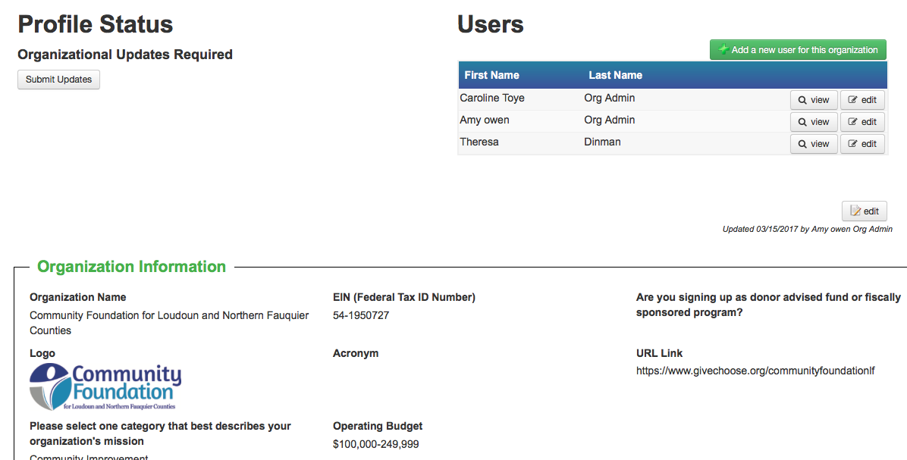
donors: what we learned
The Value of Challenge Gifts
Register it (a) under your profile (b) $ with Theresa!

Slide 25
the Prize Schedule schedule
30 Prizes YAY!
Starting with Early Gifts, Day-Of Prizes, to Grand Prizes
It’s All About the Donors

Slide 26
top gift time trends
Tuesday Morning 8 AM to 9 AM
Tuesday Morning 9 AM to 10 AM
Tuesday Afternoon 1 PM to 2 PM
Tuesday Morning 7 AM to 8 AM
Tuesday Afternoon 4 PM to 5 PM
Tuesday Afternoon 12:00 PM to 1:00 PM
Tuesday Evening 8 PM to 9 PM
Tuesday Evening 6 PM to 7 PM

Slide 27
Spiff up Your profile
deadline april 1

Slide 28
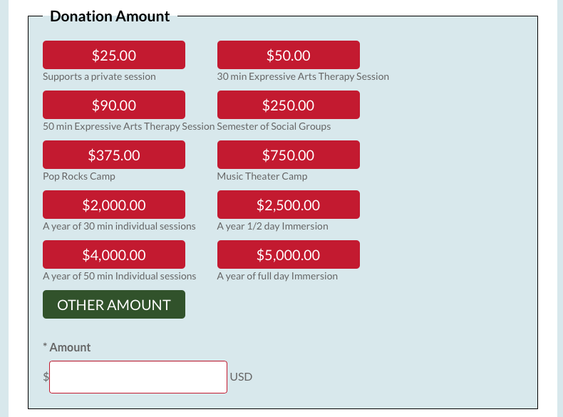
Spiff up Your profile
deadline april 1
Donation levels
Use giving levels to
Help tell your story

Slide 29
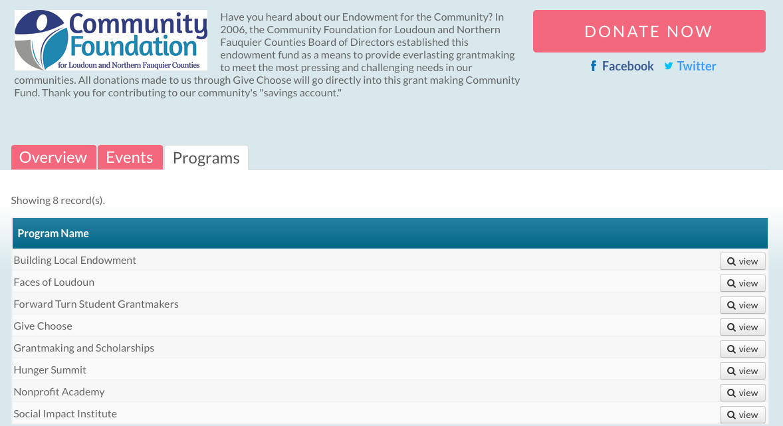
spiff Your profile
deadline april 1
Programs and Summary

Slide 30
spiff Your profile
deadline april 1
Events

Slide 31
Creating Your profile
deadline april 1
Multimedia

Slide 32
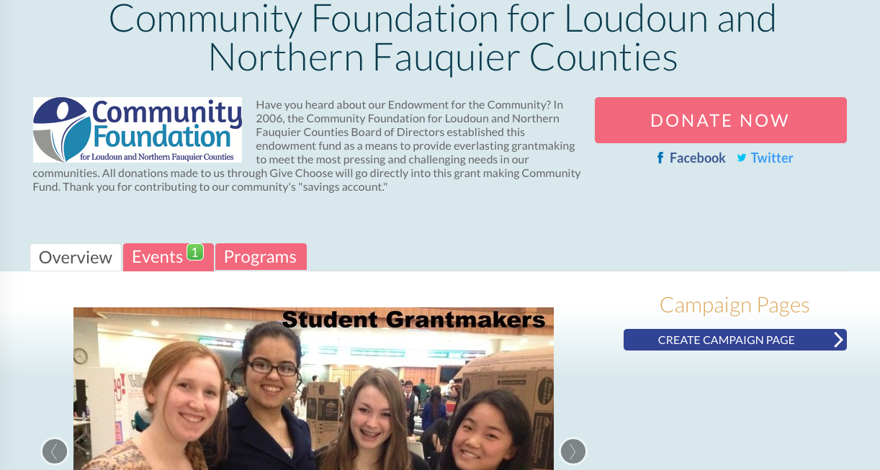
Creating Your profile
deadline april 1
Multimedia

Slide 33
One last Big tip: Actionsprout

Slide 34
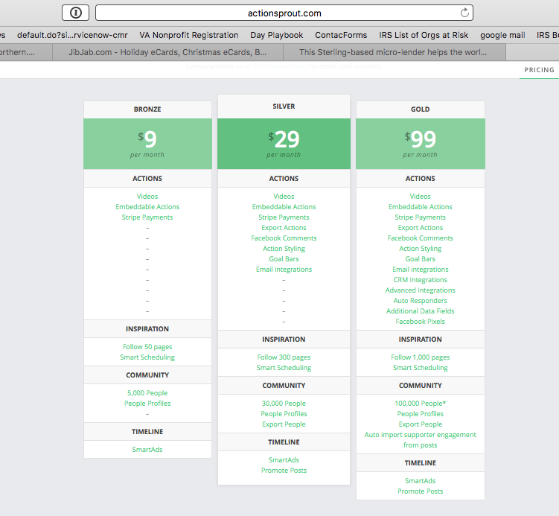
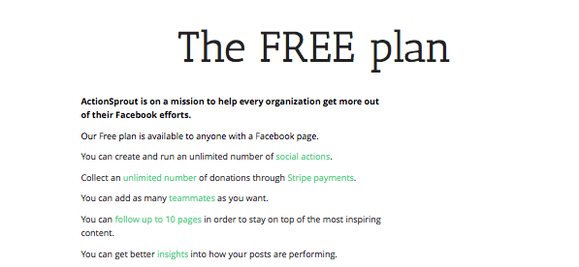
One last Big tip: Actionsprout
50 pages
300
1,000
10 Pages

Slide 35
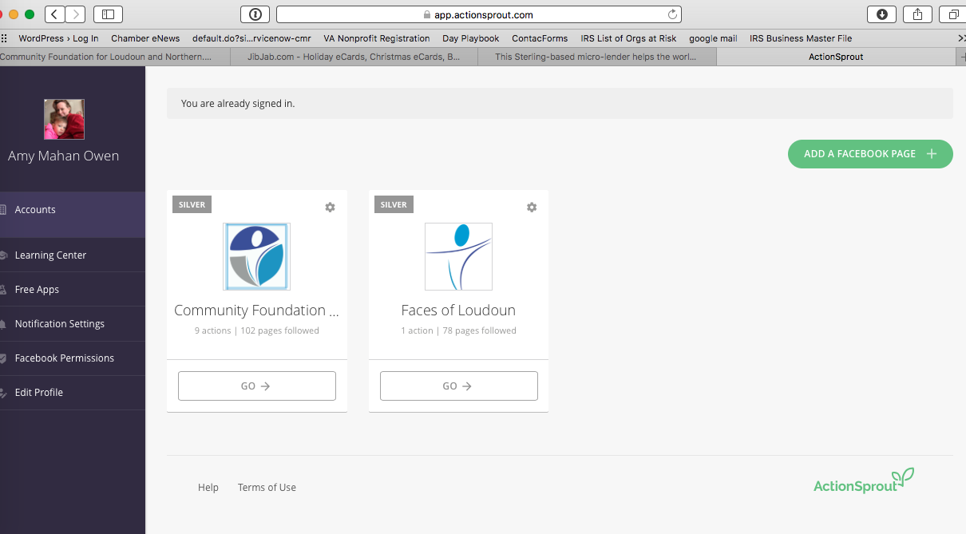
One last Big tip: actionsprout

Slide 36
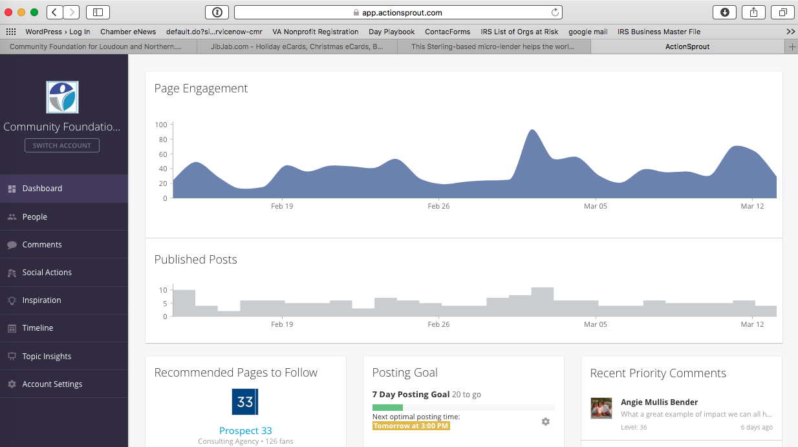
One last Big tip: actionsprout

Slide 37
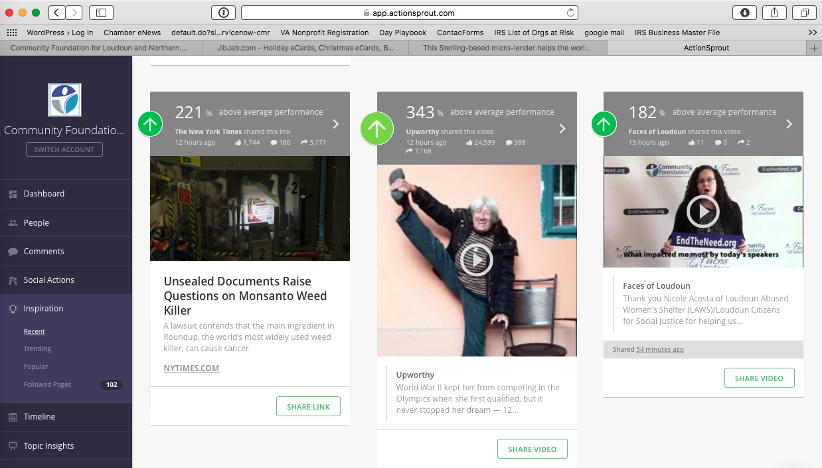
One last Big tip: actionsprout

