Slide 1
Basics of Social Media 101

Slide 2
Cyndi Urbano
Owner, AlphaGraphics Loudoun 540.454.2719 (cell)
We are a boutique marketing agency in Leesburg
Founded in 2011
We cater to nonprofit organizations
Affordable, accountable, and practical marketing solutions

Slide 3
SOCIAL MEDIA
Use social media to build support for your cause, find volunteers, acquire and retain donors, increase donations, and build thought leadership

Slide 4
Choosing the Right Social Media Channels

Slide 5
Choosing the Right Social Media Channels

Slide 6
Choosing the right channel
It’s better to manage one channel well than several channels poorly
The most popular channels among small to mid-sized nonprofits:
Facebook: 98%
Twitter: 70%
LinkedIn: 55%
YouTube: 45%

Slide 7
Choosing the right channel
The most important thing is to KNOW YOUR AUDIENCE
“If you think you are speaking to the ‘general public,’ you are most likely speaking to nobody.”

Slide 8
FACEBOOK
57% male; Average age: 38
It’s free BUT… free pages only reach 16% of the audience
BEST PRACTICES
5-10X/week (post on the weekends!)
Pictures and videos
Facebook Live and Groups
Curate as well as create
Expected response time is 2 hours
Expect to spend 10-15 hrs/week

Slide 9
FACEBOOK: BEST USES
News
Tease blog posts
Stories
>> People You Have Helped
>>Volunteers
>>How-tos
Share photo albums and videos

Slide 10
TWITTER
55% female; 60% < 35 yrs old
BEST PRACTICES
Hashtags—establish, track and thank!
Retweets
4-5X/day: Timely content
Curate as well as create
Expected response time is 1 hour
Expect to spend 15-20 hrs/week

Slide 11
TWITTER: BEST USES
Updates on Campaign/Work/Donations
News
Blog Posts
Events
Inspirational Quotes

Slide 12
LINKEDIN
414M users; Business-related
BEST PRACTICES
Post no more than 1-3X/week

Slide 13
LINKEDIN: BEST USES
Cultivating relationships with the local business community
>> Potential donors, board members, staff and volunteers

Slide 14
Social Media Best Practices

Slide 15
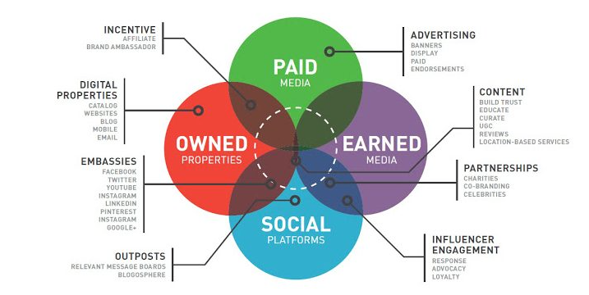
THE most common mistake
Isolating Social Media from Other Marketing/Comms Strategies

Slide 16
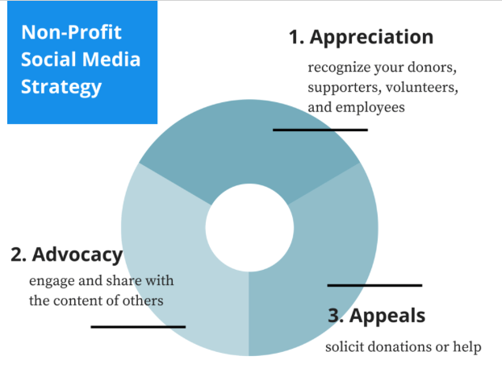
Social Media BESt practices
Content is King: Appreciation, Advocacy, Appeals
Keep it Real – and Visual and Interactive
Golden Ratio >>60% of posts from others
>>30% your content
>>10% promotional
>>Right now: 74% of nonprofits use SM exclusively as a megaphone
Engage Your Audience

Slide 17
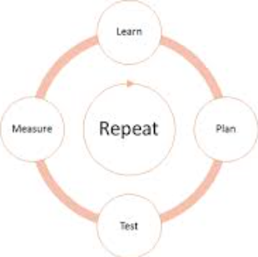
Social Media BESt practices
Test. Measure. Adjust. Repeat.
Post to each platform individually
>>Avoid auto-population mechanisms
Continue the conversation: Send people somewhere with every post
>>Website, preferably a specific landing page for the campaign
>>Blog
>>Mailing list

Slide 18
Social Media BESt practices
Be involved throughout the community
>>Like, Retweet, comment, and share
Make it easy for others to help
>>Send board members, advocates and partners sample posts and components (themes, visuals, testimonials, etc.)
Plan!

Slide 19
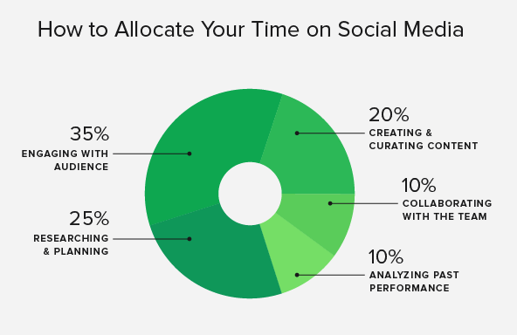

Slide 20
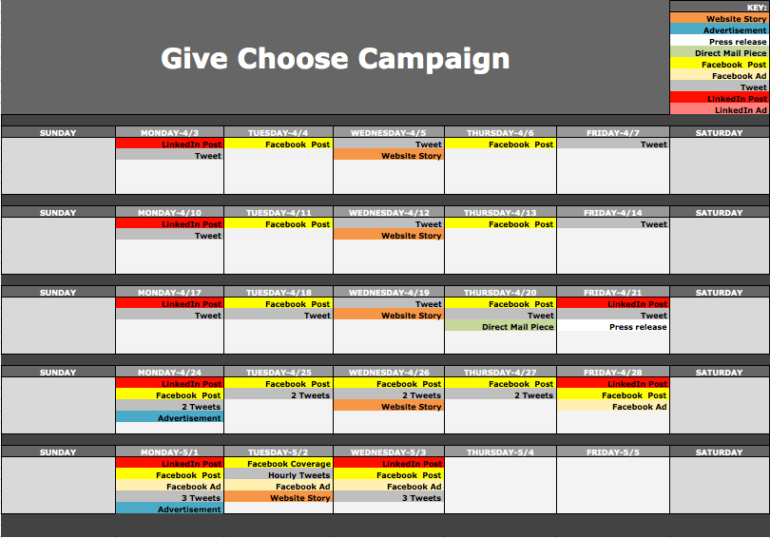

Slide 21
CALENDAR BESt practices
Strive to meet these goals:
4 pieces of content from others
1 Reshare
1 Self-Serving Post

Slide 22
IDEAs
People Stories
>>Donors and volunteers
>>People you have helped
Behind-the-Scene Stories
Thank You on Sponsor or Donor Pages
Crowdfunding
Create Your Own Wikipedia Site
Ask Questions
Closed Groups on Facebook or LinkedIn
Twitter Chats

