Slide 1
Community Giving At Its Best
May 1, 2018
GiveChoose.org

Slide 2
Today’s Agenda
9:00 – 12:00
Welcome & Introductions — Amy Owen
Overview of Give Choose — Amy
Get Your Plan Planned!— Cyndi Urbano
Q&A - (All)

Slide 3
What is it?
One day - 24 hour online fundraising event organized by the Community Foundation for Loudoun and Northern Fauquier Counties.
To inspire our community to come together for 24 hours to give as much as possible to our local NPOs.
24 hours of giving begins at midnight on May 1 and ends at 11:59 PM.
Early giving begins April 17th at 12:01 AM
Each nonprofit will have their own donation page to include their logos, and information
Throughout the day, individuals can click through to your landing page and make a charitable gift on GiveChoose.org

Slide 4
Why participate?
Visibility:
for your organization and for the local
nonprofits in our area.
Capitalize On A Moment In Time:
one day - 24 hours -
brings energy and momentum.
Be A Part Of Something Big:
an important local community
movement.
Create Stronger Alignment:
Board, Donors, Community.
Prizes, Prizes, Prizes: oh boy.

Slide 5
Why participate?
Individual Giving is the #1 source of revenue for nonprofits. Nationwide, 80% of charitable giving comes from individuals (that includes 8% in bequests).
Raise Unrestricted Dollars: unrestricted dollars are hard to come by.
New Giving Behavior: Giving Days help introduce and reinforce new giving behaviors that can help lead to greater year round giving.
Reach New Donors: 33% of donations in both 2014 and 2015 came from new donors; 55% in 2016; 52% in 2017.

Slide 6
History of Give Choose
 | 2014 | 2015 | 2016 | 2017
Donations Total | $65,000 | $136,000 | $180,000 | $222,543
NPs with Challenge Gifts | 6 ($12,000) | 12 ($32,000) | 17 ($55,350) | 19 ($62,900)
Number of Donors | 604 | 936 | 922 | 1,119
NPs active | 40 | 48 | 60 | 86

Slide 7
Give CHOOSE OUtreach
Banner on Toll Toad leading up to May 1
Loudoun Now sponsorship for online and print ads
Middleburg Eccentric ad
Wee cards
Posters
Community Foundation Facebook Ads to reach new donors
YOU!

Slide 8
how much does it cost?
Nothing – up front
All donations are fully tax-deductible. Of each gift, 4.99% covers credit card fees and helps to offset Give Choose expenses
It will take the Community Foundation up to 60 days to disperse funds (to allow for credits and reconciliation)

Slide 9
Eligibility & Requirements
501(c)(3) public charity in good standing with the IRS (Fiscal sponsorship and funds within the Community Foundation accepted)
Must be headquartered, have a branch or provide direct services to either Loudoun or Fauquier Counties.
Apply with a preliminary profile on GiveChoose.org by April ???. Be sure to include Statement of Agreement
Complete your profile by April ???

Slide 10
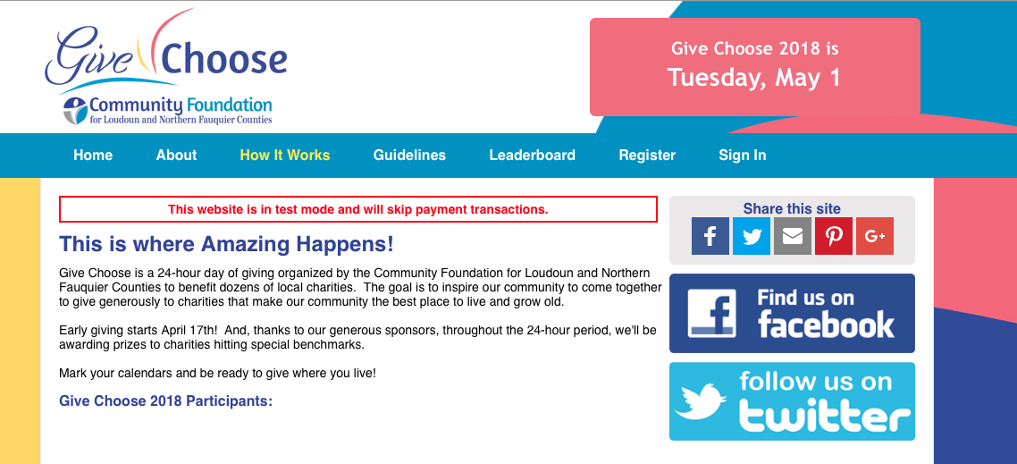
Registration dealine April 10

Slide 11
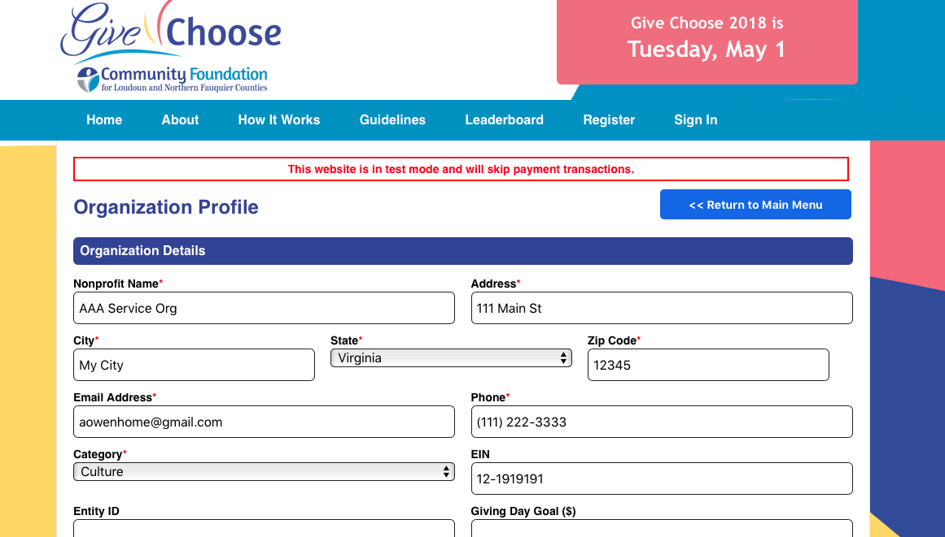
Registration dealine April 10
Logos
Mission
Matching/Challenge Gift

Slide 12
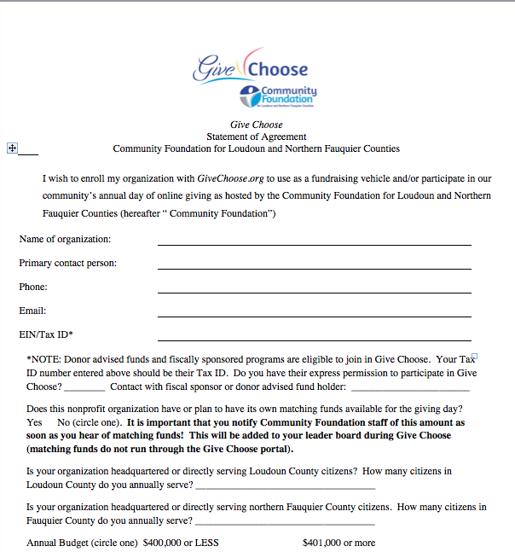
Registration dealine April 10

Slide 13
goals for 2018
$250,000 in Total Donations
25 NPOs have Matching Gifts
1,500 Donors
90 Nonprofits

Slide 14
donors: what’VE we learned
How Did You Learn About Give Choose?
 | 2017 | 2016 | 2015 | 2014
Email from a charity | 63% | 66% | 72% | 51%
Email from the Community Foundation/Other Source | 26%/6% | 17%/3% | 21%7% | 1%/2%
A friend/family member told me | 18% | 25% | 14% | 26%
I saw it in print/media | 5% | 4% | 5% | 1%
I saw it in electronic media | 12% | 11% | 12% | 2%
I saw a poster | 5% | 9% | 9% | 2%
I saw it on Facebook | 30% | 24% | 22% | 44%
I saw it on Twitter | 3% | 3% | 2% | 1%
I saw it on the Toll Road | 7% | 7% | n/a | n/a

Slide 15
donors: what we’VE learned
What Charities Did You Support During Give Choose?
 | 2017 | 2016 | 2015
Groups I support or have supported in the past | 86% | 86% | 74%
Groups I have heard of but never supported | 22% | 25% | 33%
Groups I discovered through Give Choose | 8% | 9% | 3%
2014
64%
35%
12%
*In 2014 of the 604 donors, 215 had never before given a gift to that Nonprofit
*In 2015 of the 936 donors, 312 had never before given a gift to that Nonprofit
*In 2016 of the 922 donors, 502 had never before given a gift to that Nonprofit
*In 2017 of the 1,119 donors, 588 had never before given a gift to that Nonprofit

Slide 16
donors: what we have learned
How long have you lived/worked in Loudoun/Fauquier?
 |  |  | 2017 | 2016 | 2015 | 2014
Less than one year |  |  | 0% | 4% | 0% | 0%
1 - 2 Years |  |  | 2% | 5% | 5% | 2%
3 - 5 Years |  |  | 6% | 9% | 5% | 7%
6+ Years |  |  | 72% | 71% | 76% | 47%
I do not live or work here. |  |  | 20% | 11% | 14% | 44%
Did you tell other people about Give Choose?
 |  |  | 2017 | 2016 | 2015 | 2014
NO |  |  | 32% | 9% | 5% | 7%
YES |  |  | 72% | 71% | 76% | 47%

Slide 17
donors: what we learned
Our Sponsors helped to create a Prize Pool. How influential were those prizes as you decided to give?
 |  |  | 2017 | 2016 | 2015 | 2014
Very Influential |  |  | 17% | 14% | 21% | 28%
Influential |  |  | 17% | 25% | 12% | 26%
Indifferent |  |  | 22% | 12% | 15% | 13%
Not Important |  |  | 18% | 23% | 28% | 16%
I did not know about Matching Gifts |  |  | 28% | 26% | 24% | 16%

Slide 18
donors: what we’ve learned
Some NPs had matching gifts set up in advance from donors to match your gift made. How compelling were matches as you decided to give?
 |  |  | 2017 | 2016 | 2015
Very Compelling |  |  | 28% | 25% | 31%
Compelling |  |  | 28% | 30% | 29%
Indifferent |  |  | 17% | 13% | 9%
Not Compelling |  |  | 12% | 17% | 12%
I did not know about Matching Gifts |  |  | 15% | 16% | 19%

Slide 19
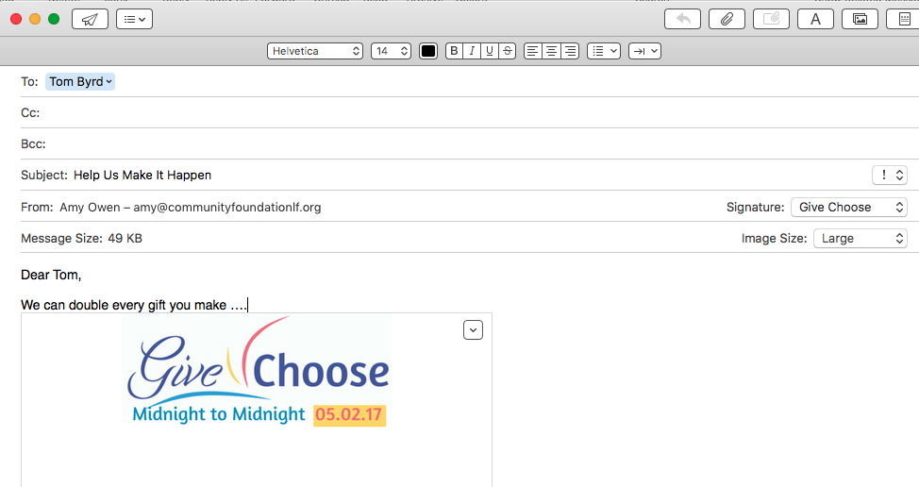
donors: what we learned
The Value of Challenge Gifts
55% to 60% say they were influenced by YOUR Challenge Gift

Slide 20
donors: what we learned
The Value of Challenge Gifts
Register it Amy Owen by email.
Lead with it in your NP Profile on Give Choose
Showcase it in your emails and notices to your donors

Slide 21
the Prize Schedule schedule
30 Prizes YAY!
Starting with Early Gifts, Day-Of Prizes, to Grand Prizes

Slide 22
One last Big tip: Actionsprout

Slide 23
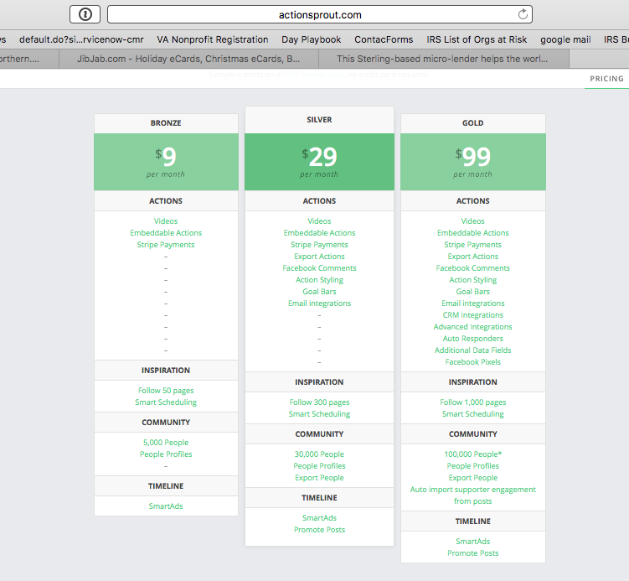
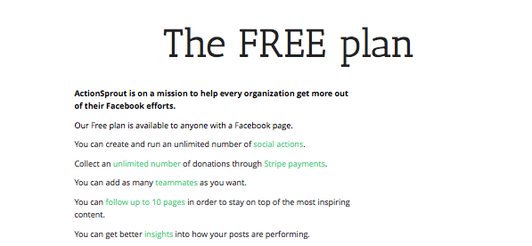
One last Big tip: Actionsprout
50 pages
300
1,000
10 Pages

Slide 24
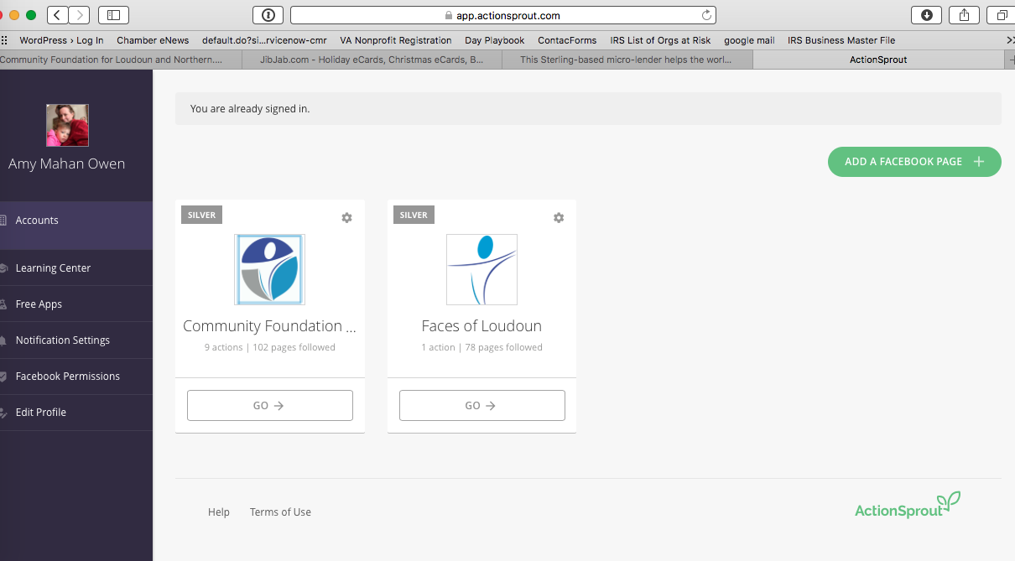
One last Big tip: actionsprout

Slide 25
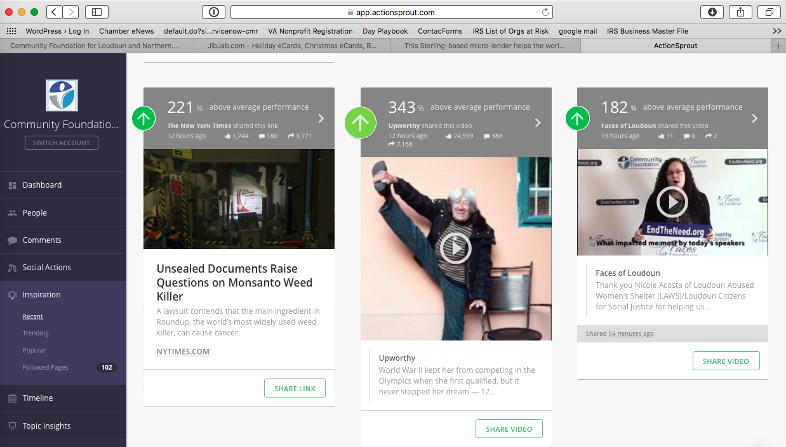
One last Big tip: actionsprout

