Slide 1
Basics of Social Media 101

Slide 2
Cyndi Urbano
Owner, AlphaGraphics Loudoun 540.454.2719 (cell)
We are a boutique marketing agency in Leesburg
Founded in 2011
We cater to nonprofit organizations
Affordable, accountable, and practical marketing solutions

Slide 3
SOCIAL MEDIA
Ad spend on social media will OUTPACE ad spend on TV for the FIRST TIME EVER

Slide 4
SOCIAL MEDIA
1 in 5
In 2017, 21% of peer-to-peer donations were raised as the result of a direct click through on social media

Slide 5
SOCIAL MEDIA
Use social media to:
build support for your cause
find volunteers
acquire and retain donors
increase donations
build thought leadership

Slide 6
Choosing the Right Social Media Channels

Slide 7
Choosing the right channel
86%
Of Americans Use the Internet

Slide 8
Choosing the Right Social Media Channels

Slide 9
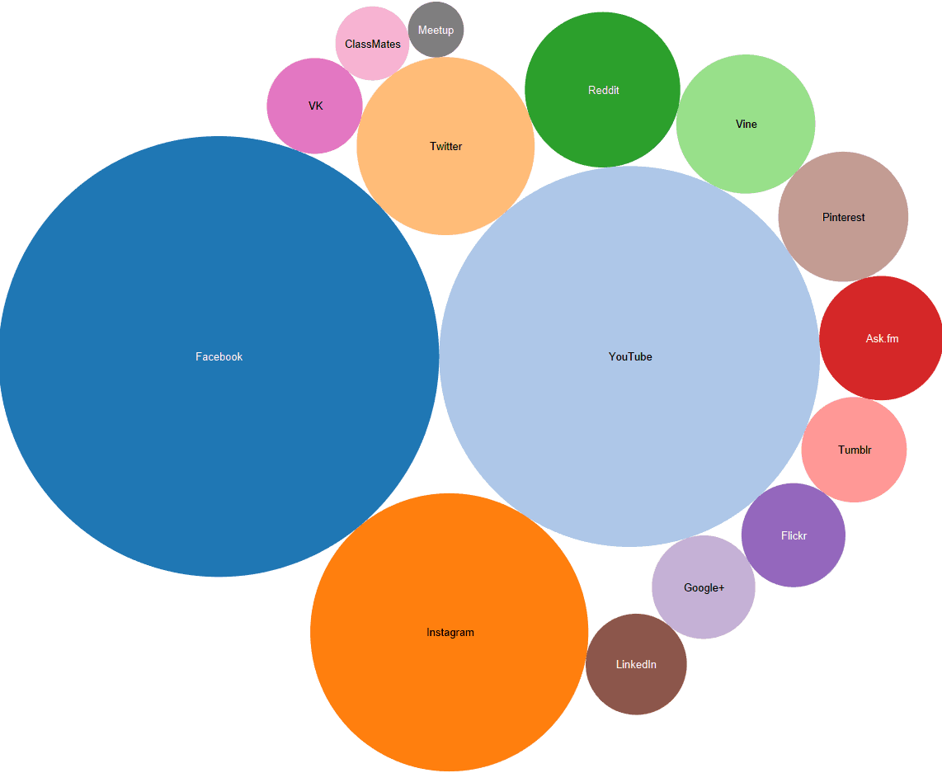

Slide 10
FACEBOOK
2 BILLON
Monthly Users
1 BILLION+
Active Users a Day

Slide 11
FACEBOOK
79% of American adults use Facebook
83% of women use Facebook
75% of men use Facebook
70% of Facebook users use it daily
88% of 18-29
84% of 30-49
72% of 50-64
62% of 65+

Slide 12
FACEBOOK
It’s free BUT…free pages only reach 16% of the audience

Slide 13
FACEBOOK: BEST PRATICES
5-10X/week (post on the weekends!)
Pictures and videos (more than 100M hours of videos are viewed on Facebook daily)
Facebook Live and Groups
Curate as well as create
Expected response time is 2 hours
Expect to spend 10-15 hrs/week
Best Time to Post: Wednesday through Sunday with Thursday being the best. Anytime between 9 am and 3 pm with 1 pm being ideal.

Slide 14
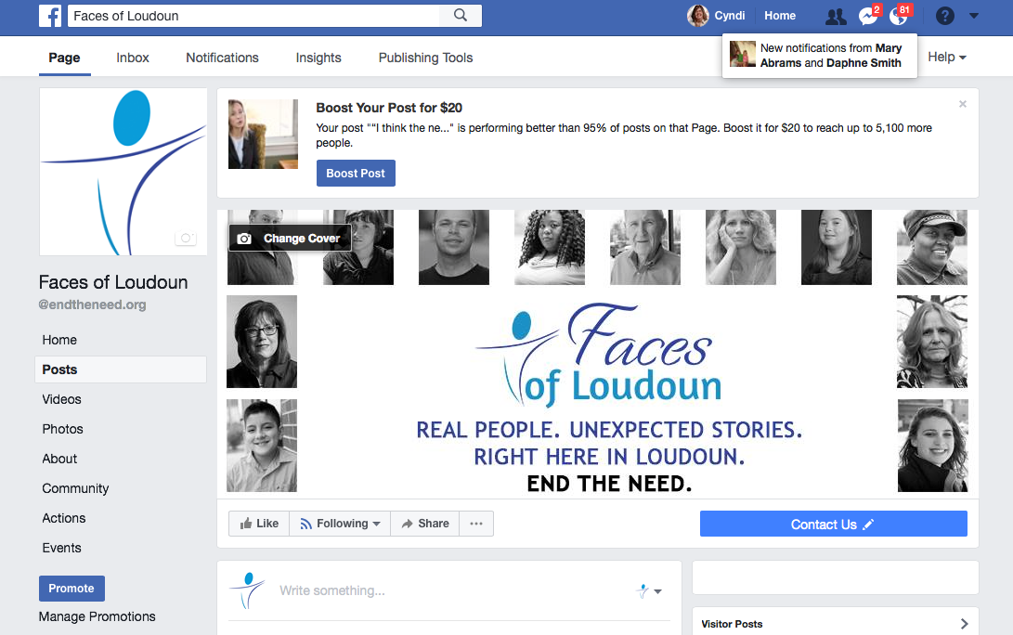
FACEBOOK: BOOSTING

Slide 15
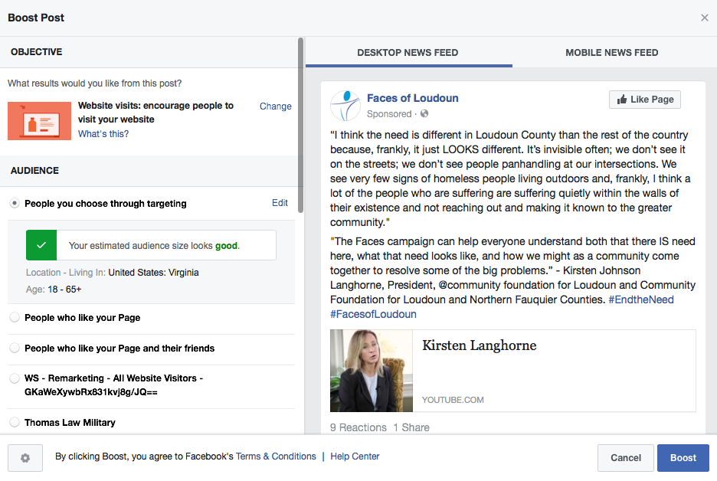
FACEBOOK: BOOSTING

Slide 16
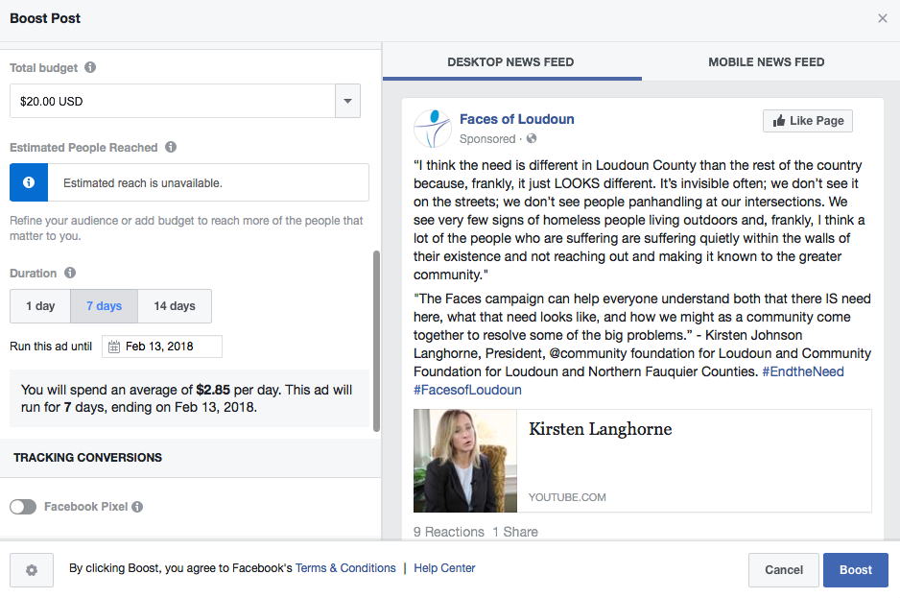
FACEBOOK: BOOSTING

Slide 17
FACEBOOK: BEST USES
News
Tease blog posts
Stories
>> People You Have Helped
>>Volunteers
>>How-tos
Share photo albums and videos

Slide 18
YOUTUBE
1 BILLION monthly users (133M in US)

Slide 19
YOUTUBE
29% of US adults use LinkedIn
45% of women use LinkedIn
55% of men use YouTube
2 MILLION Views/MINUTE!
YouTube reaches more 18-49 year olds than any cable network

Slide 20
YOUTUBE: BEST PRACTICES
Make it compelling—create a connection
Add fresh content frequently
Pay attention to titles and descriptions
Include a Call to Action
Check out YouCaring

Slide 21
YOUTUBE: BEST USES
Tell stories
Interviews
News
Follow-on stories on beneficiaries

Slide 22
TWITTER
317 MILLION
Monthly Users

Slide 23
TWITTER
Nearly 79% of Twitter users are OUTSIDE the US
24% of US adults use Twitter
15% of women use Twitter
22% of men use Twitter
42% of Twitter users use it daily
81% of millennials use Twitter daily
15% check it at least 10X/day

Slide 24
TWITTER: BEST PRACTICES
Hashtags—establish, track and thank!
Retweets
4-5X/day: Timely content
Curate as well as create
Expected response time is 1 hour
Expect to spend 15-20 hrs/week
Best Time to Post: Monday through Friday, with Thursday being ideal. Between noon and 3pm with noon being the sweet spot.

Slide 25
TWITTER: BEST USES
Updates on Campaign/Work/Donations
News
Blog Posts
Events
Inspirational Quotes

Slide 26
LINKEDIN
467 MILLION users (133M in US)

Slide 27
LINKEDIN
29% of US adults use LinkedIn
27% of women use LinkedIn
31% of men use LinkedIn
18% of LinkedIn users use it daily
34% of 18-29
33% of 30-49
24% of 50-64
20% of 65+

Slide 28
LINKEDIN: BEST PRATICES
Post no more than 1-3X/week
Best Time to Post: Tuesday through Thursday, with Thursday being ideal.
Between noon and 5 pm on Tuesday and Thursday being the sweet spot.

Slide 29
LINKEDIN: BEST USES
Cultivating relationships with the local business community
>> Potential donors, board members, staff and volunteers

Slide 30
Choosing the right channel
It’s better to manage one channel well than several channels poorly
The most popular channels among small to mid-sized nonprofits:
Facebook: 98%
Twitter: 70%
LinkedIn: 55%
YouTube: 45%

Slide 31
Choosing the right channel
The most important thing is to KNOW YOUR AUDIENCE
“If you think you are speaking to the ‘general public,’ you are most likely speaking to nobody.”

Slide 32
Social Media Best Practices

Slide 33
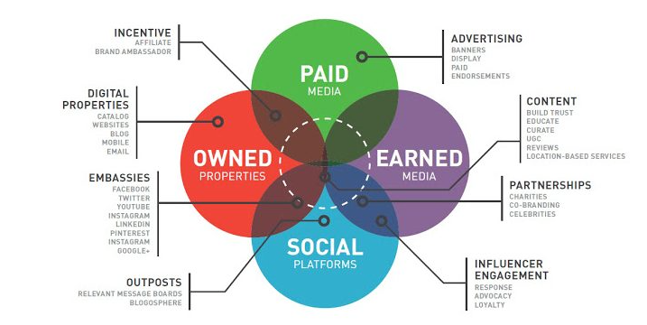
THE most common mistake
Isolating Social Media from Other Marketing/Comms Strategies

Slide 34
Social Media BESt practices
The average duration of online fundraising campaigns is
9 weeks
However… 30-day campaigns actually work best

Slide 35
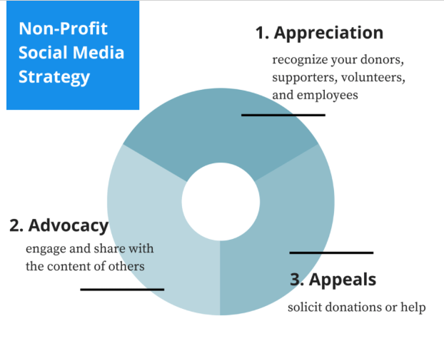
Social Media BESt practices
Content is King: Appreciation, Advocacy, Appeals
Keep it Real – and Visual and Interactive.
Campaigns with Personal Videos Raise
105% More
than Campaigns Without Videos

Slide 36
Social Media BESt practices
Golden Ratio >>60% of posts from others
>>30% your content
>>10% promotional
>>Right now: 74% of nonprofits use social media exclusively as a megaphone
Engage Your Audience

Slide 37
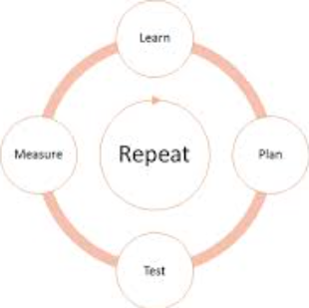
Social Media BESt practices
Test. Measure. Adjust. Repeat.
Post to each platform individually
>>Avoid auto-population mechanisms
Continue the conversation: Send people somewhere with every post
>>Website, preferably a specific landing page for the campaign
>>Blog
>>Mailing list

Slide 38
Social Media BESt practices
Be involved throughout the community
>>Like, Retweet, comment, and share
Make it easy for others to help
>>Send board members, advocates and partners sample posts and components (themes, visuals, testimonials, etc.)
Plan! It typically takes nonprofits 2 weeks to plan an effective campaign

Slide 39
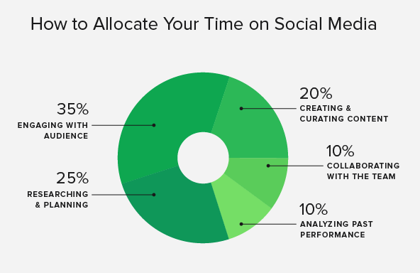

Slide 40
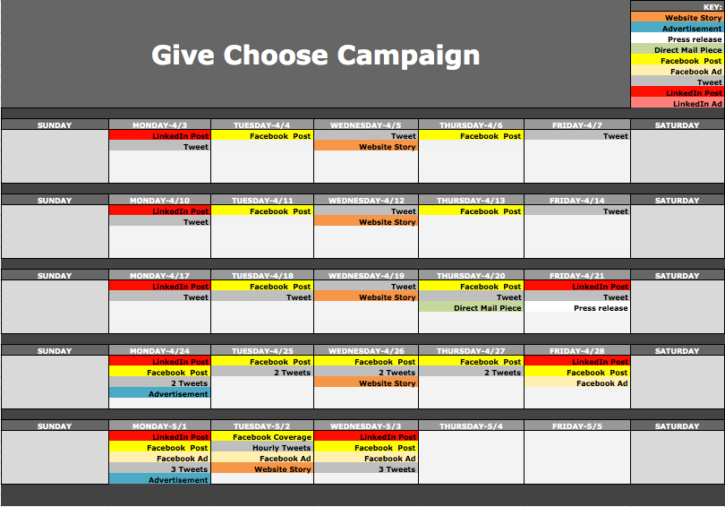

Slide 41
CALENDAR BESt practices
Strive to meet these goals:
4 pieces of content from others
1 Reshare
1 Self-Serving Post

Slide 42
IDEAs
People Stories
>>Donors and volunteers
>>People you have helped
Behind-the-Scene Stories
Thank You on Sponsor or Donor Pages
Crowdfunding
Create Your Own Wikipedia Site
Ask Questions
Closed Groups on Facebook or LinkedIn
Twitter Chats

Slide 43
STORIES FROM THE FRONT LINES
CHARLI
We put in little effort 2 years ago—and our results reflected that
Last year, we set a goal specific to Give Choose—and we made that! We have almost doubled that goal for this year.
The biggest thing was realizing I did not have to reinvent the wheel
--I used the schedule handed out at the training last year. It was very helpful.
--I researched the campaigns and creative other nonprofits used. They were my inspiration.

Slide 44
STORIES FROM THE FRONT LINES
MAYA
I emailed out a countdown to everyone in my database
I engaged each member of my board early and often
--I provided them a timeline, script, talking points, and objectives
--I specifically asked them to reach out to their networks
I posted client stories to Facebook
On the day of:
--I was a cheerleader all day
--I posted frequent updates to Facebook
--I emailed updates to my database

Slide 45
STORIES FROM THE FRONT LINES
RACHEL
I treated Give Choose like a full-blown fundraising campaign; it is our biggest fundraiser every year
I sent an email to everyone in my database 2 weeks prior
I started posting to Facebook 2 weeks prior, 1 week prior and then 1 day before
On the day of:
--I worked the campaign non-stop, posting to Facebook every hour
--I went to my gym and announced Give Choose at the class. We got 10 donations just from that.
--We had a great donor match to provide a sense of urgency
--We broadcast which hour we wanted to win and I texted throughout that hour

Slide 46
STORIES FROM THE FRONT LINES
BEN
We pursued a strategy of building partnerships with other organizations to increase awareness of Give Choose as an event rather than raising funds for our organization

Slide 47
Thank You!

